Slide 1


Diplomatura en Ciencias de Datos
Trabajo Práctico Final
Módulo 2
Integrantes:
Gamboa Juliana
Mancini Andrés
Pavelek Israel

Slide 2
Objective
The aim of the project is to predict those customers with the highest propensity to cancel the bank's credit card, which is known as Churn. We want to predict the value of the column Attrition_Flag in the dataset

Slide 3
Steps
Exploratory Data Analysis
Split between
training and test set
Train using diferents clasifications models
Show results

Slide 4
Understanding the dataset
Exploratory Data Analysis
Column | Data type
CLIENTNUM | int64
Attrition_Flag | object
Customer_Age | int64
Gender | object
Dependent_count | int64
Education_Level | object
Marital_Status | object
Income_Category | object
Card_Category | object
Months_on_book | int64
Column | Data type
Total_Relationship_Count | int64
Months_Inactive_12_mon | int64
Contacts_Count_12_mon | int64
Credit_Limit | float64
Total_Revolving_Bal | int64
Avg_Open_To_Buy | float64
Total_Amt_Chng_Q4_Q1 | float64
Total_Trans_Amt | int64
Total_Trans_Ct | int64
Total_Ct_Chng_Q4_Q1 | float64
Avg_Utilization_Ratio | float64

Slide 5
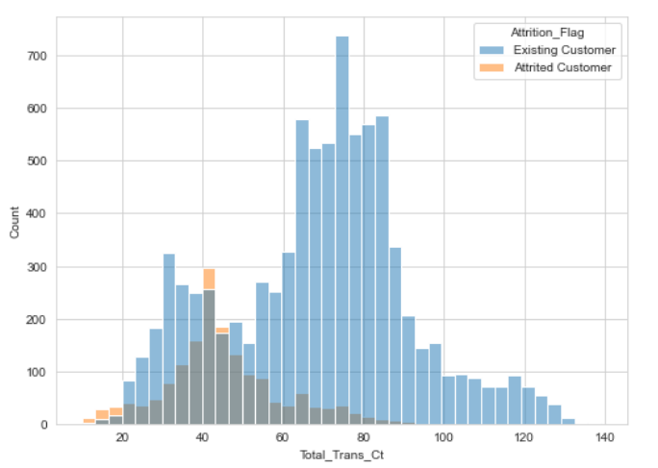
Transactions vs kind of client
Some data from de data set
Existing Customer | 83.93%
Attrited Customer | 16.1%
Attrition_Flag

Slide 6
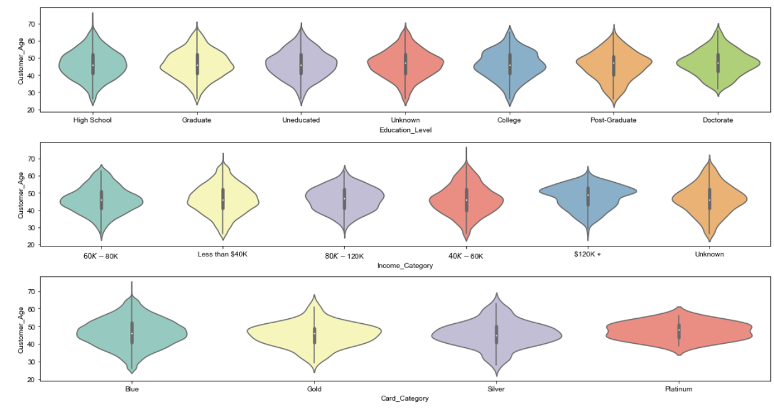
Classifying the clients.

Slide 7
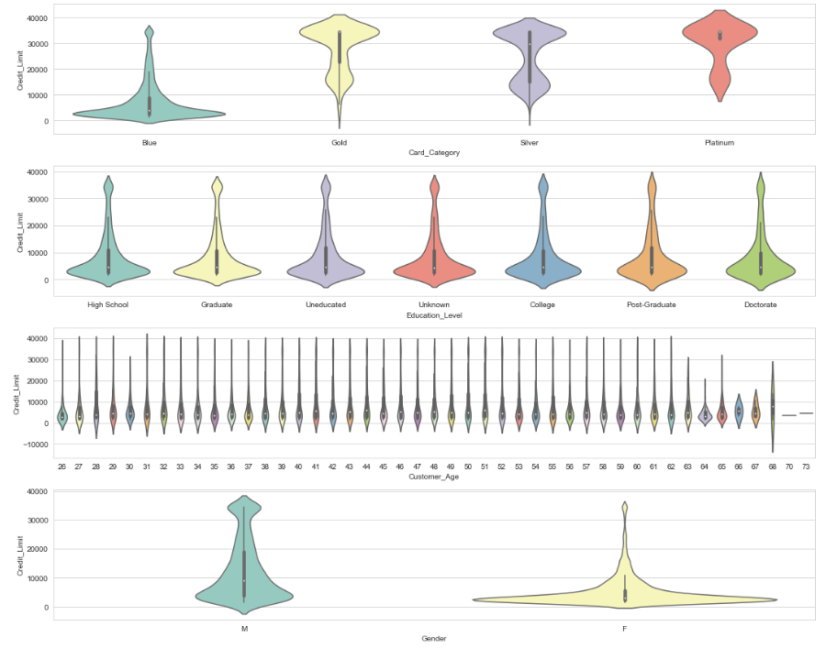

Slide 8
Categorical Variables
1st
Imputation of unknown
Conversion to numeric (mappers)
Marital_Status
Single (0)
Married (1)
Divorced (3)
Unknown (x)
2nd
Some are:
Attrition Flag
Existing Customer (0)
Attrited Customer (1)
Gender
F (0)
M (1)
Education_Level
Uneducated (0)
High School (1)
College (2)
Graduate (3)
Post.Graduate (4)
Doctorate (5)

Slide 9
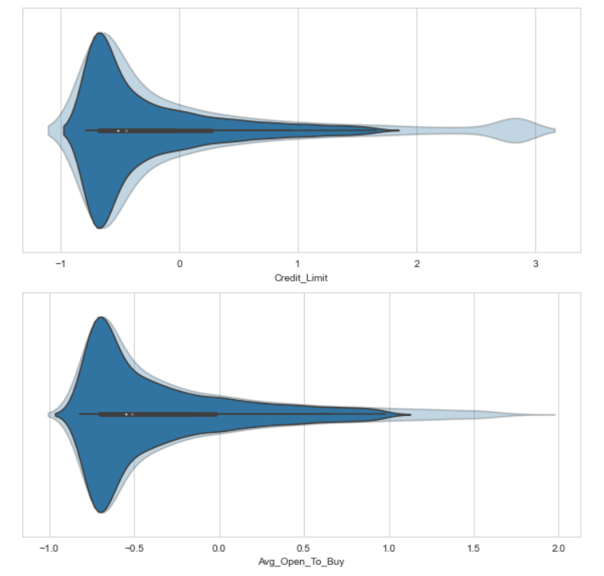
Dealing with outliers
DataFrame size before outlier treatment: (10120, 20)
DataFrame size after outlier treatment: (8620, 20)

